Slide 1
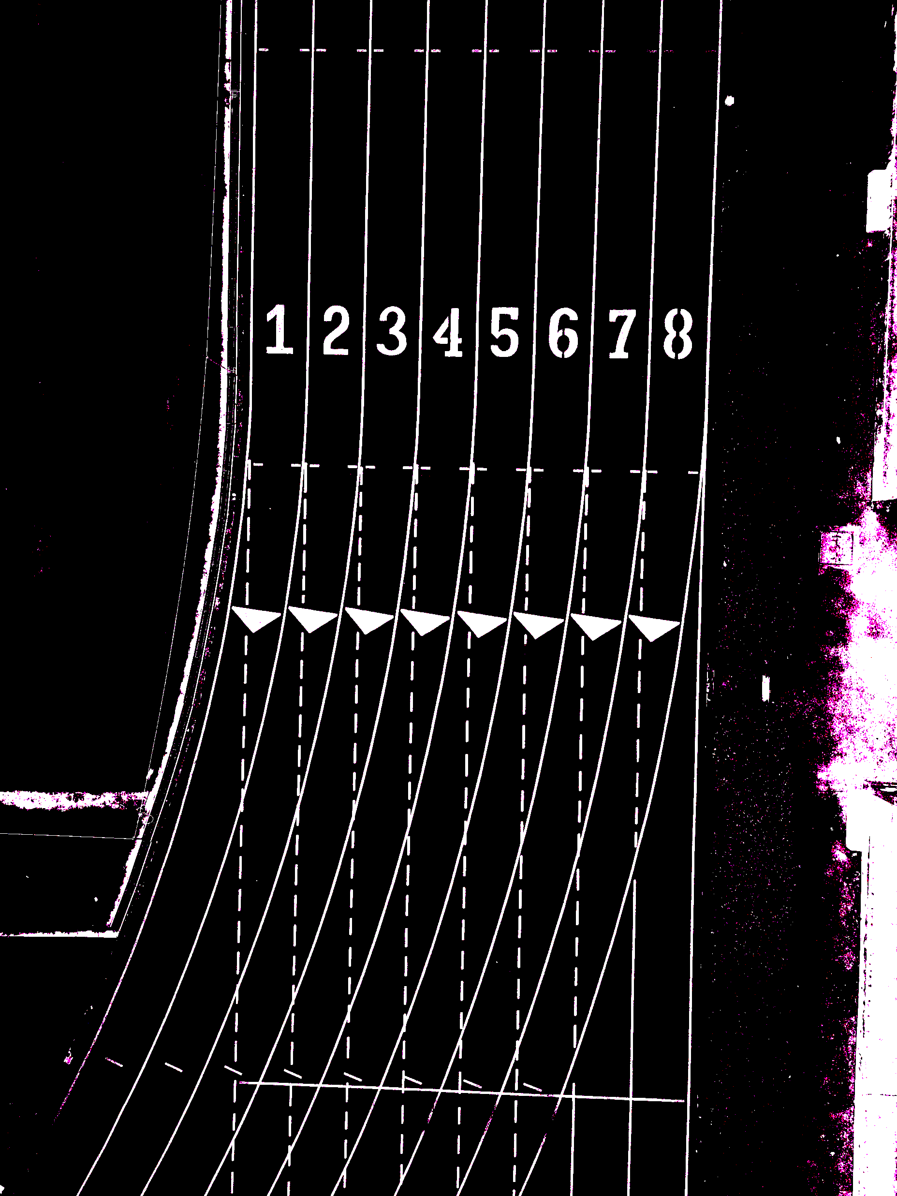
HPC 24/25 Solving Heat Equation in parallel: the 5-Point Stencil method
Invernici Marta

Slide 2
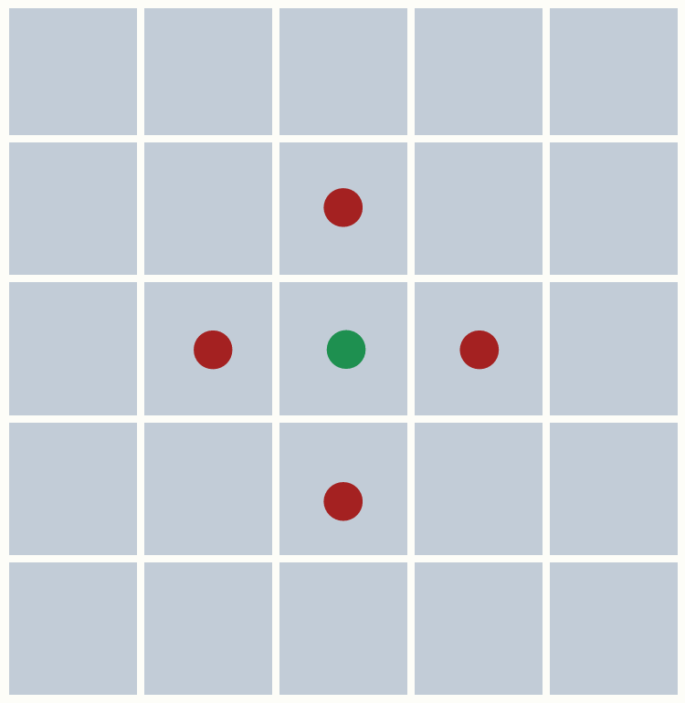
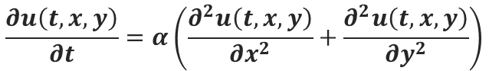
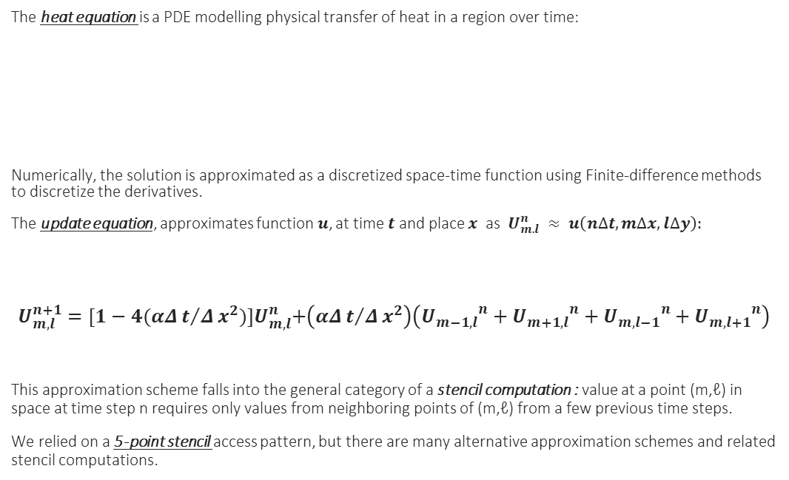
The numerical problem
The heat equation is a PDE modelling physical transfer of heat in a region over time:
Numerically, the solution is approximated as a discretized space-time function using Finite-difference methods to discretize the derivatives.
The update equation, approximates function$u$, at time $t$ and place $x$ as $U_{m.l}^{n} ≈ u\left(n∆t,m∆x,l∆y\right):$
$$U_{m,l}^{n+1}={[1−4(αΔt/Δx^{2})]U}_{m,l}^{n}+\left(αΔt/Δx^{2}\right)\left({U_{m−1,l}}^{n}+{U_{m+1,l}}^{n}+{U_{m,l−1}}^{n}+{U_{m,l+1}}^{n}\right)$$
This approximation scheme falls into the general category of a stencil computation : value at a point (m,ℓ) in space at time step n requires only values from neighboring points of (m,ℓ) from a few previous time steps.
We relied on a 5-point stencil access pattern, but there are many alternative approximation schemes and related stencil computations.
$$\frac{∂u\left(t,x,y\right)}{∂t}=α\left(\frac{∂^{2}u\left(t,x,y\right)}{∂x^{2}}+\frac{∂^{2}u\left(t,x,y\right)}{∂y^{2}}\right)$$

Slide 3
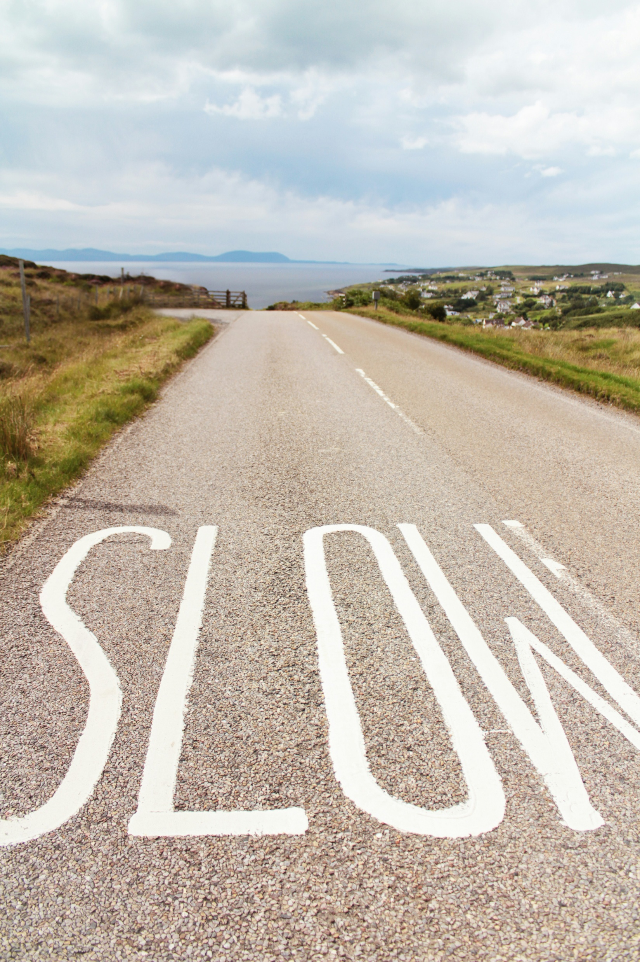

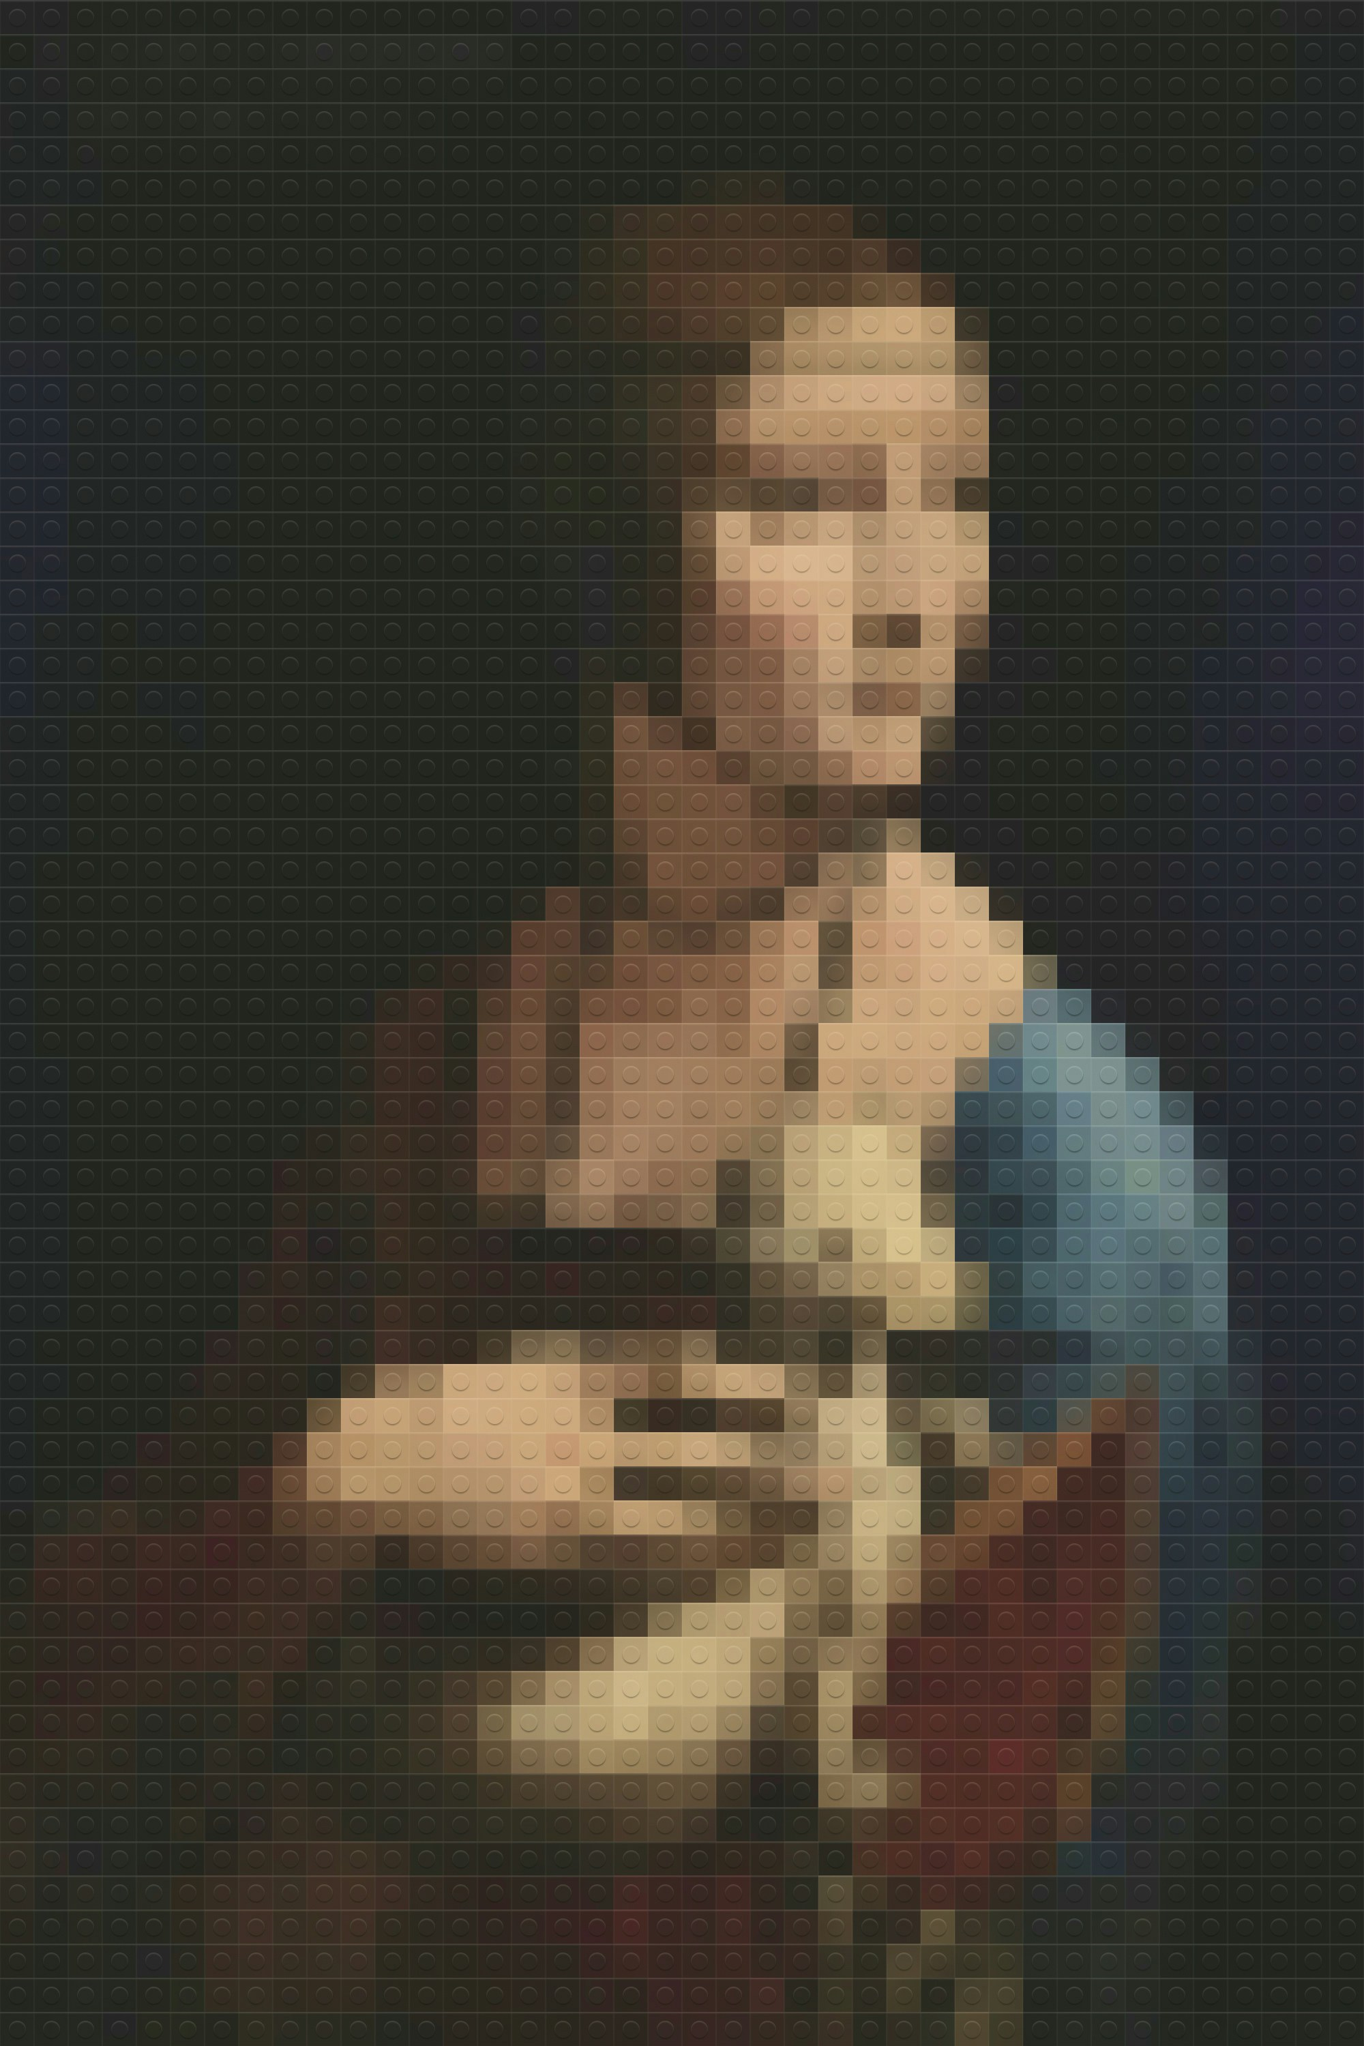
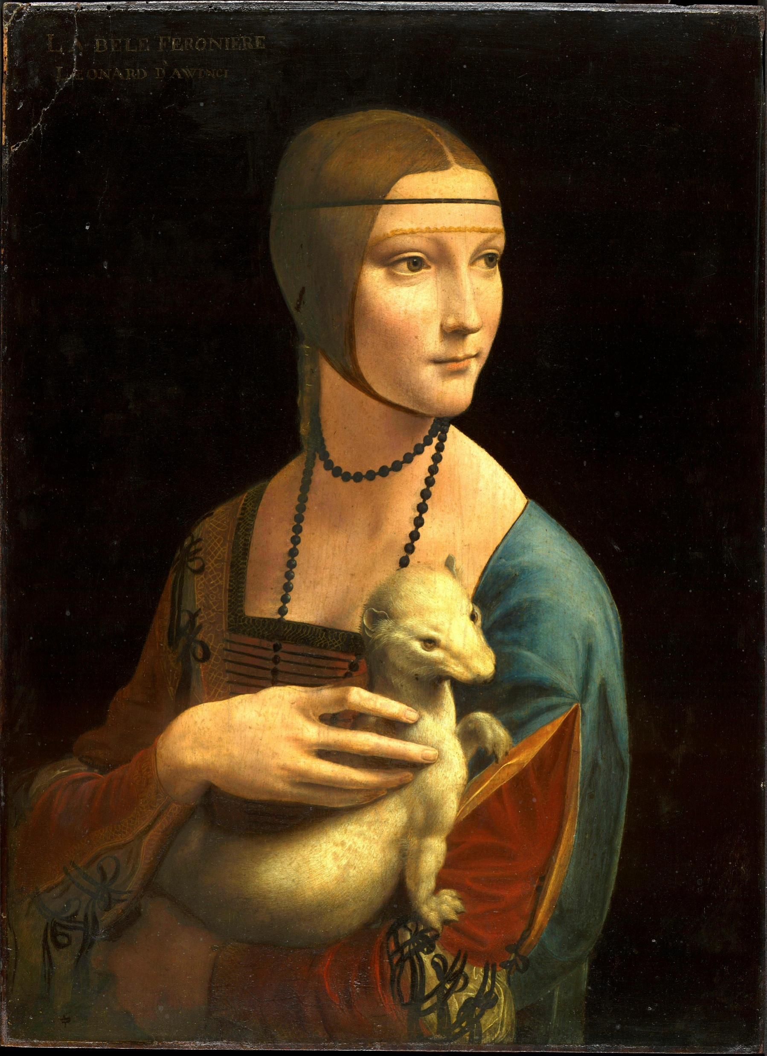


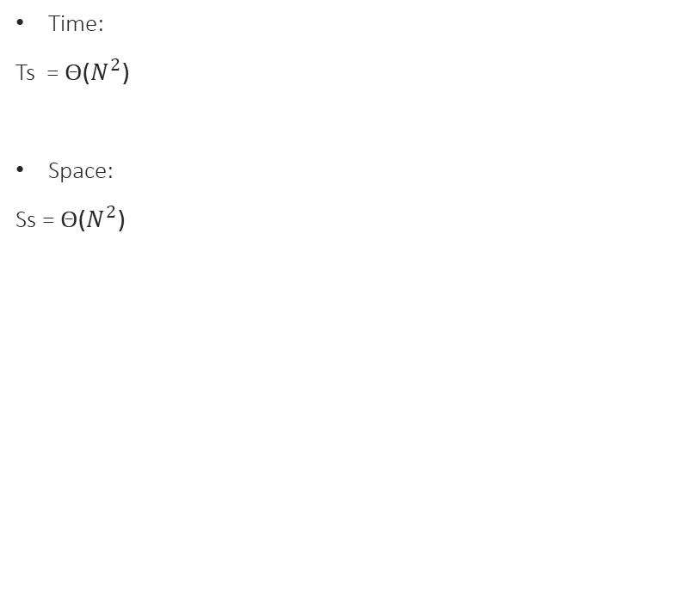
Constraints of serial programming
Perks of parallel programming & HPC
Time:
Ts = Θ($N^{2}$)
Space:
Ss = Θ($N^{2}$)
Fixed problem size, decreased time
(Strong scaling)
Bigger problem size, constant time
(Weak scaling)
Beyond single-node limits
BUT:
Overhead

Slide 4
Hybrid Parallel Implementation
OpenMP
Shared Memory regime
#pragma omp parallel for schedule(static)
plane_update
memory_allocate (grid initialization)
#pragma omp parallel for reduction(+: totenergy)
get_total_energy
MPI
Distributed Memory regime
MPI_Init_thread, MPI_Comm_rank, MPI_Comm_size, MPI_Comm_dup, MPI_Finalize
initialization and finalization of MPI env
MPI_Isend, MPI_Irecv, MPI_Waitall, MPI_Test
non-blocking P-2-P communications and assessment
MPI_Bcast, MPI_Reduce, MPI_Gather
initilalize_sources
output_energy_stat
time results
MPI_Wtime()

Slide 5
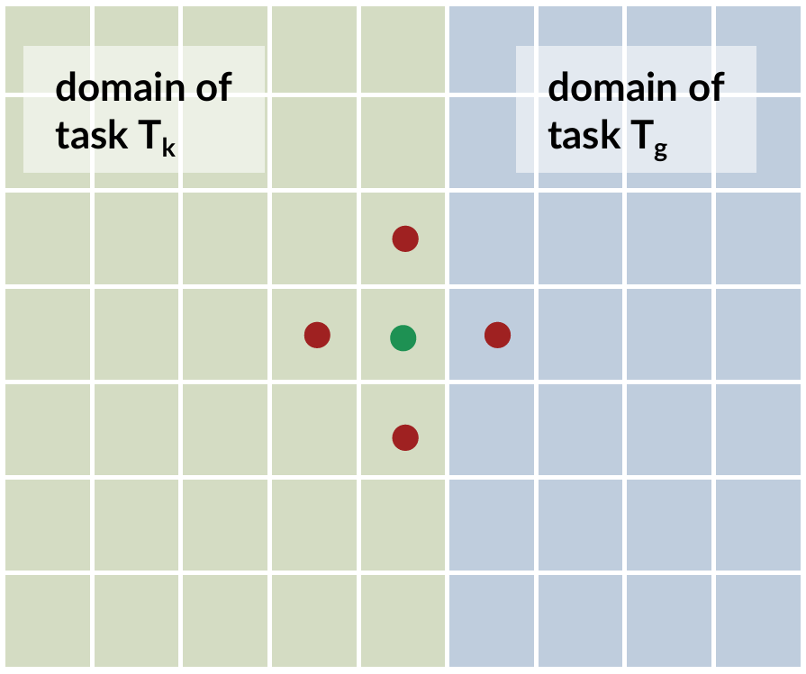
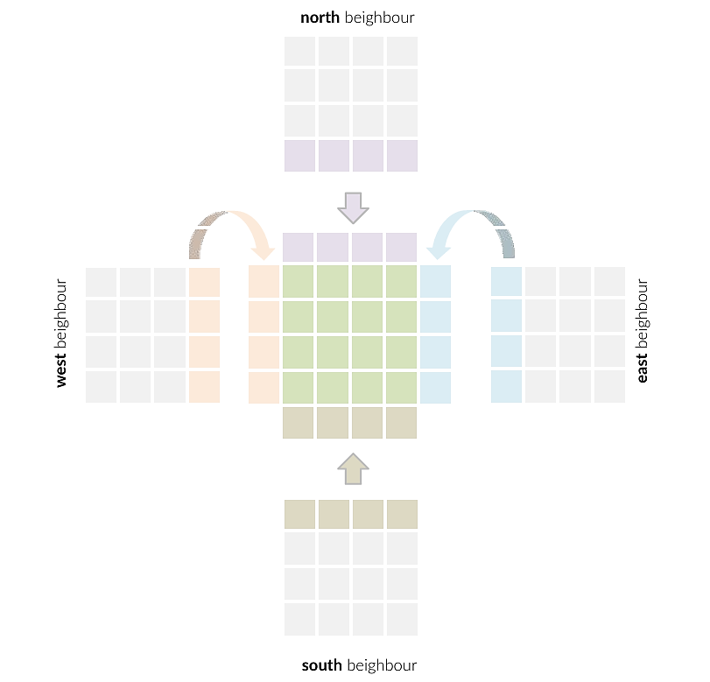
Domain Decomposition & Communications
Hybrid model: MPI_Init_thread requesting FUNNELED; OpenMP does the intra-rank work.
Domain decomposition: neighbor array (N/E/S/W); edges handled with MPI_PROC_NULL.
Halo buffers: N/S halos as contiguous rows; E/W halos via temporary column buffers.
Non-blocking halo exchange: MPI_Isend / MPI_Irecv with consistent per-direction tags.
Comm/comp overlap: update the inner grid while messages are in flight; finalize with MPI_Waitall.
Border completion: after receives complete, copy halos into the plane, then update border cells.

Slide 6
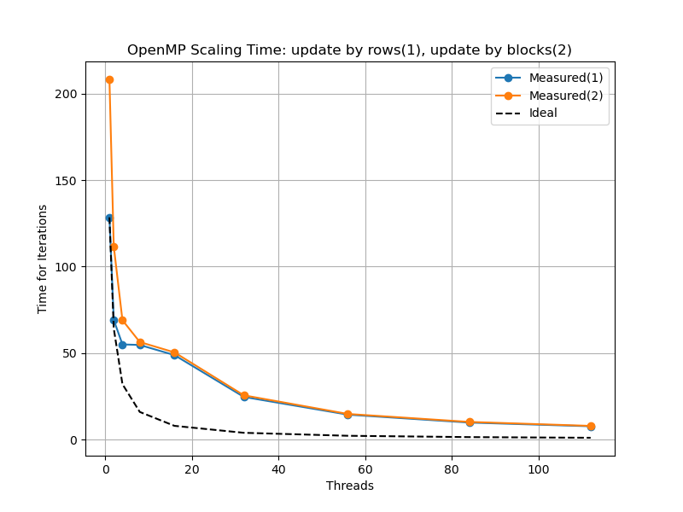
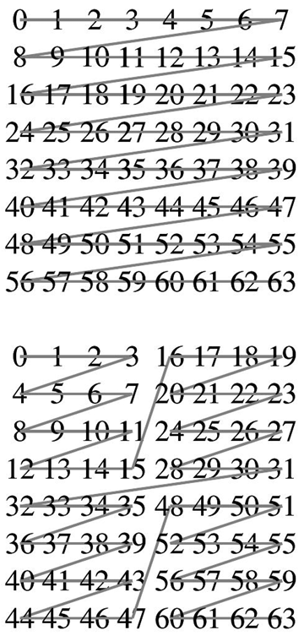
Computing Grid Updates
Orfeo EPYC: 2x(16x4) cores, 512 GB
Row-order (1) or Block-order(2) scan for locality enhancement
Touch-by-all with parallel malloc initialization to place pages locally
Static scheduling for predictable locality
Comm/comp overlap : Inner grid update + Borders update
OMP_PLACES=cores, OMP_PROC_BIND=close for memory affinity

Slide 7
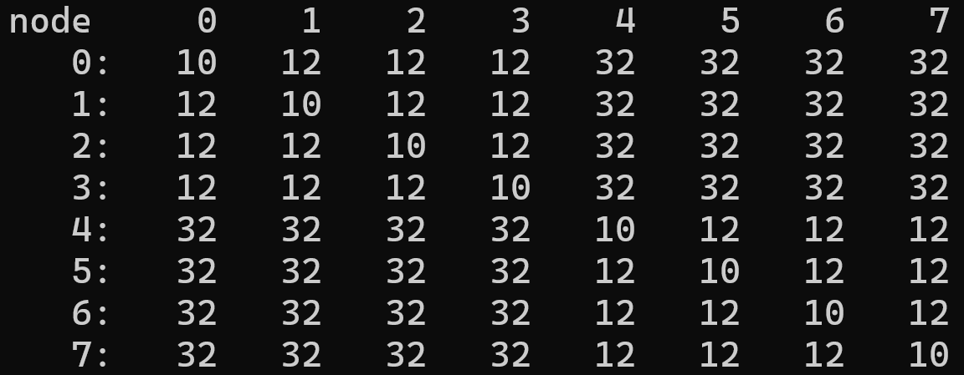
Computing Grid Updates
Orfeo EPYC: 2x(16x4) cores, 512 GB
Row-order (1) or Block-order(2) scan for locality enhancement
Touch-by-all with parallel malloc initialization to place pages locally
Static scheduling for predictable locality
Comm/comp overlap : Inner grid update + Borders update
OMP_PLACES=cores, OMP_PROC_BIND=close for memory affinity
(?) $≈$ 16 t. : DRAM bandwidth saturation + false sharing
more parallel resources > overhead

Slide 8
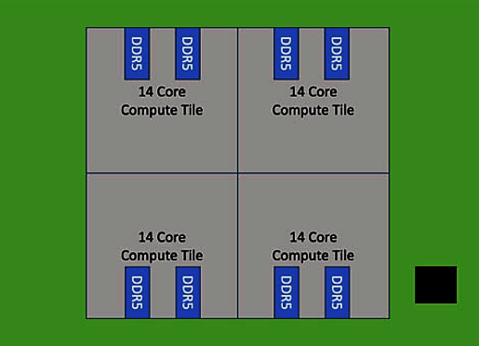
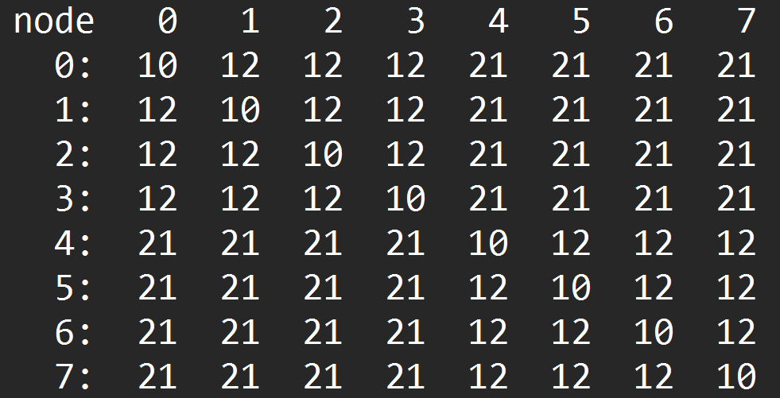
Leonardo – DCGP Module
Data Centric General Purpose (DCGP) module
1536 nodes , 172032 CPU cores
https://leonardo-supercomputer.cineca.eu/hpc-system/#jump-partition
Three-node BullSequana X2140 blade.
Each NODE has:
2x 56-core Intel Xeon Platinum 8480+ CPU
(side: conceptual diagram)
2x 8x 32 GB DDR5-4800 (512 GB)

Slide 9
Scalability tests

Slide 10
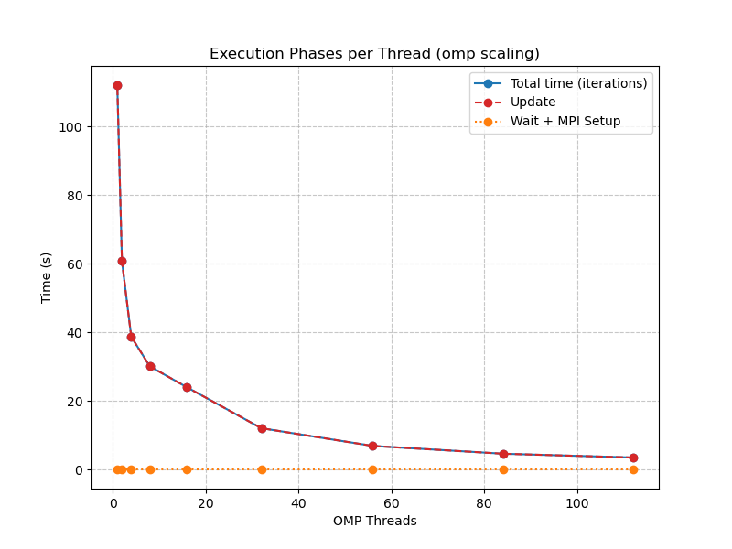
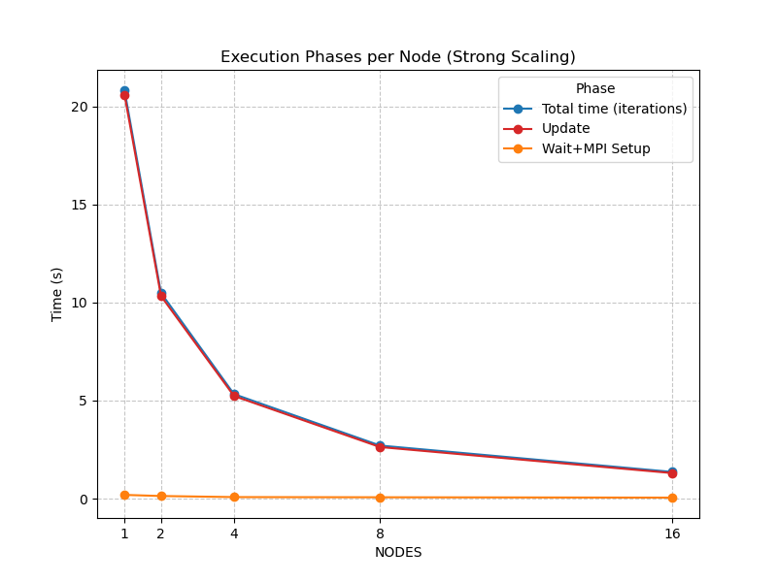
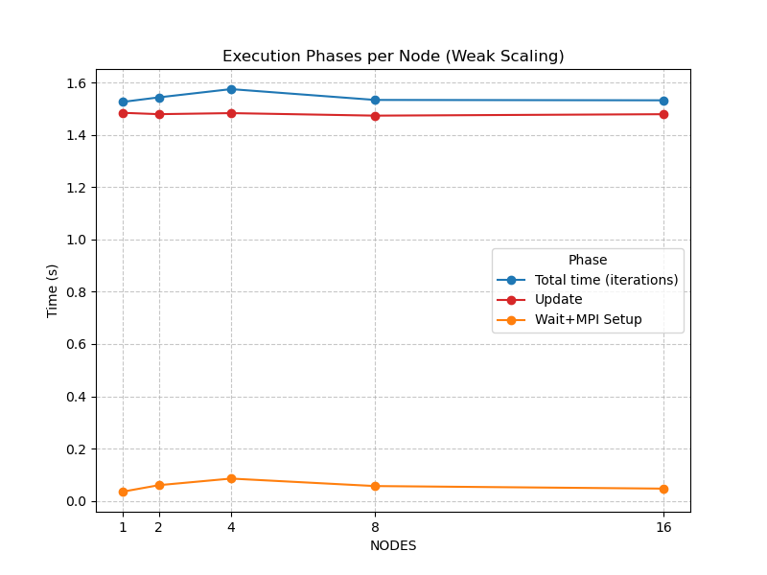
Communication and Computation TIMES
Test threads: 1 2 4 8 16 32 56 84 112; Test nodes: 1 2 4 8 16 nodes

Slide 11
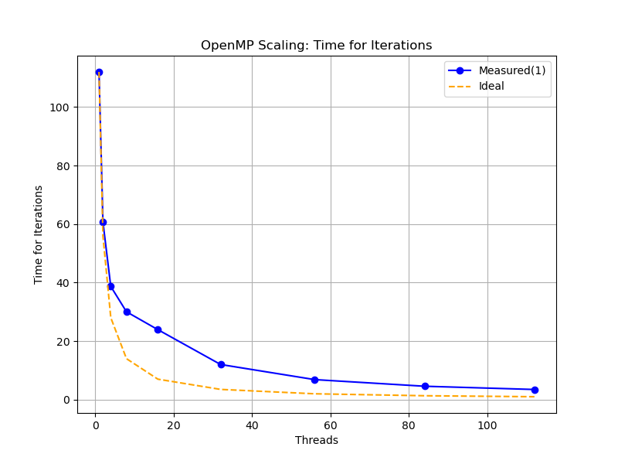
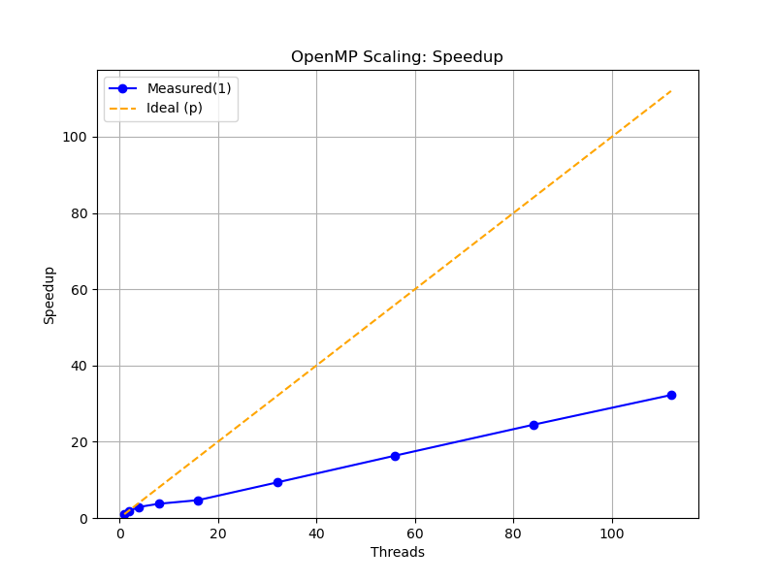
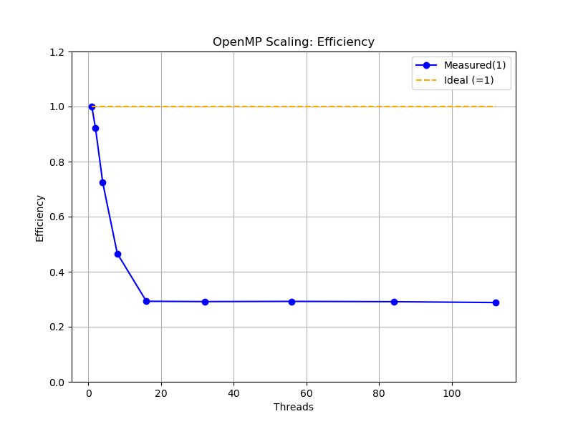
OPENMP SCALING
Test points: 1 2 4 8 16 32 56 84 112 threads; Grid Size: 10000x10000; Iterations: 750

Slide 12
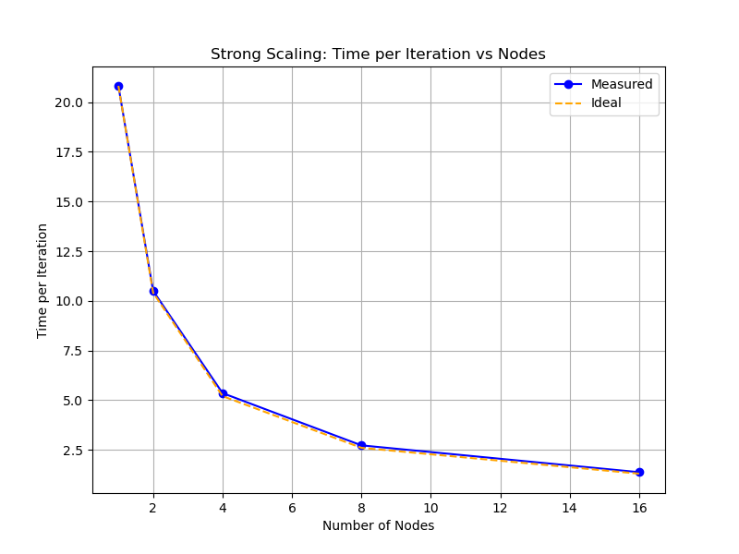
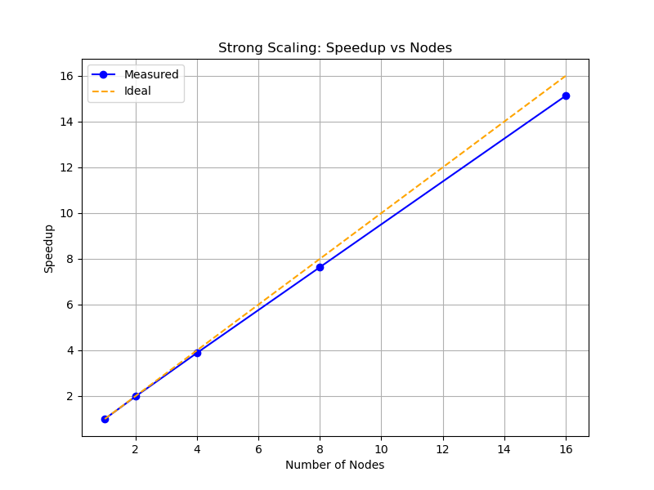
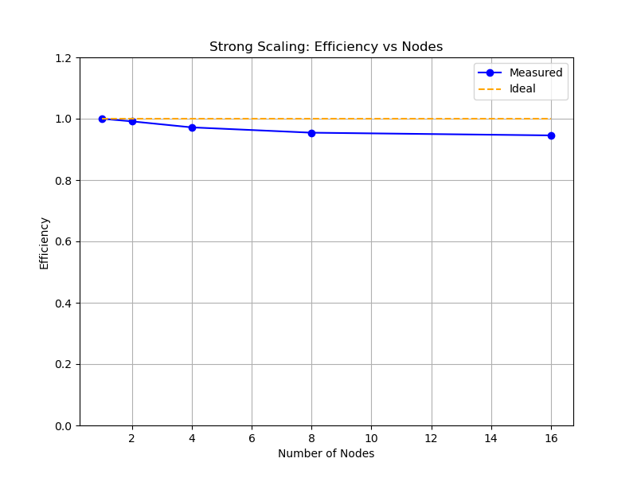
STRONG SCALING
Node: 14 threads-per-task * 8 tasks; Test points: 1 2 4 8 16 nodes; Grid Size: 15000x15000; Iterations: 500
*All timings are wall-time of the slowest rank

Slide 13
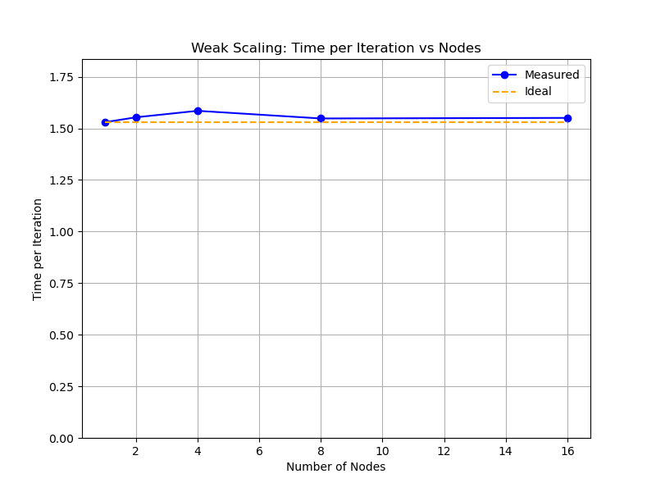
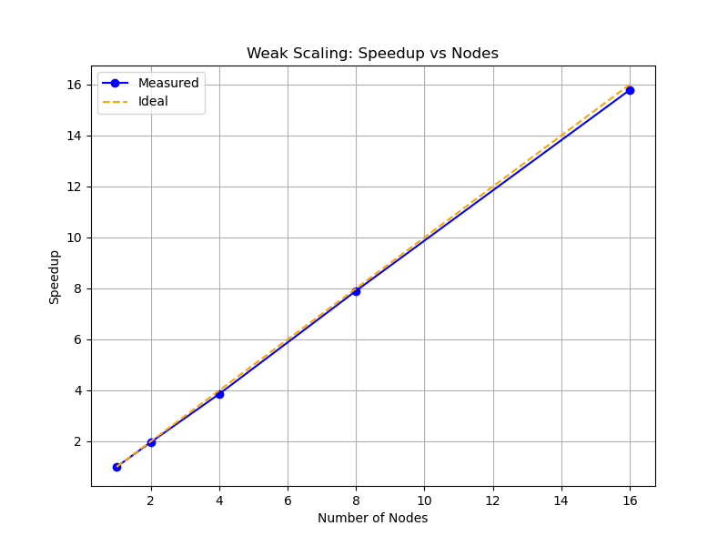
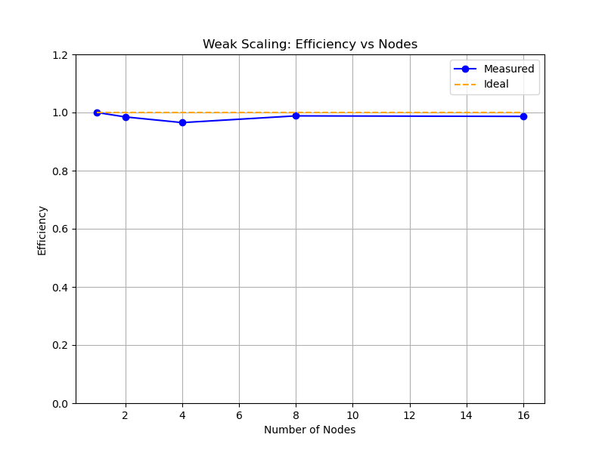
WEAK SCALING
Node: 14 threads-per-task * 8 tasks; Test points: 1 2 4 8 16 nodes; Grid Size: 4000² 8000x4000 8000² 16000x8000 16000² ; Iterations: 500
*All timings are wall-time of the slowest rank

Slide 14
To infinity and beyond, i.e. possible enhancements
Goals achieved. Hybrid MPI+OpenMP 5-point stencil with compute/comm overlap; timings are wall-time of the slowest rank; scaling is solid (OMP up to the DRAM/NUMA knee; strong/weak as expected); communications are not the bottleneck—the grid update dominates.
Where time goes: The grid update dominates the runtime; communication is largely hidden by overlap and does not set the pace.
Top priority now. Strengthen the update kernel with more update parallelism and cache locality to reduce memory traffic.
Why: the stencil is likely memory-bandwidth bound. Each update touches several neighbors and does a store; if data isn’t reused in cache, we re-fetch lines from DRAM and even remote NUMA, wasting bandwidth. Possible working direction to follow to push performance:
Tiling to keep working sets in L1/L2/L3 caches;
SIMD to update several cells with one fetch;
Local allocation, sticking threads to their cores to keep accesses local;
Padding/alignment lowers false sharing pushing performance toward the bandwidth roofline.

Slide 15
Thank you

